Slide 1

Contemporary Business Mathematics with Canadian Applications
Eleventh Canadian Edition
Chapter 5
Cost-Volume-Profit Analysis and Break-Even
Copyright © 2018 Pearson Canada Inc.
Notes:
If this PowerPoint presentation contains mathematical equations, you may need to check that your computer has the following installed:
1) MathType Plugin
2) Math Player (free versions available)
3) NVDA Reader (free versions available)

Slide 2
Objectives
Construct and interpret cost-volume-profit charts.
Compute break-even values using cost-volume-profit relationships.
Compute break-even values using contribution margin and contribution rate.
Compute the effects of changes to cost, volume, and profit.

Slide 3
Cost-Volume-Profit Analysis and Break-Even
One of the main concerns to owners and management in operating a business is profitability. To achieve or maintain a desired level of profitability, managers must make decisions that determine product quantity, total revenue, and total cost. The potential effects of decisions on profitability can be computed.

Slide 4
Case (1 of 4)
Jason is a recent graduate from the Kwantlen Polytechnic University’s (KPU) horticulture program. Jason is planning to start a business producing vegetables in particular bell peppers. Jason’s father has a good sized greenhouse in his yard which is available for Jason to rent. His father requires $500 per month for the use of his greenhouse. Three important factors in greenhouse growing are lighting, temperature, and humidity. Jason has conducted research believes they can managed by upgrading the greenhouse at a cost of $500 per month. In addition, he will need to purchase seeds, fertilizer, net pots, clay pebbles, and some other supplies.

Slide 5
Case (2 of 4)
Jason estimates that the cost for all the necessary supplies will be 20 cents for each bell pepper he produces. Water and electricity use are expected to cost 10 cents per bell pepper. He thinks he can produce a maximum of 3000 bell peppers every month. The local market for bell peppers is $4.20 per pack of 3 bell peppers, but he anticipates he may have to price down each pack and sell his peppers for $3 per pack ($1 for each bell pepper) to be able to compete.

Slide 6
Analysis
Number of Bell Peppers 0 300 1500 3000
Revenue
Greenhouse rent
Greenhouse Upgrade
Total cost
Net Income

Slide 7
Case (3 of 4)
To determine his expected profit, Jason calculated his income based on the number of bell peppers he could produce each month.
Number of Bell Peppers | 0 | 300 | 1500 | 3000
Revenue | 0 | 300 | 1500 | 3000
Greenhouse rent | 500 | 500 | 500 | 500
Greenhouse Upgrade | 500 | 500 | 500 | 500
Total cost | 1000 | 1090 | 1450 | 1900
Net Income | −$1,000.00 | −$790.00 | $50.00 | $1,100.00

Slide 8
Case (4 of 4)
Jason wanted to know if there was a way of determining how many bell peppers. he needed to produce and sell to cover his expenses. He also wanted to know how to determine the effects on the net income of changes in the price per bell pepper, the cost of materials, and other costs.

Slide 9
Cost-Volume Assumptions (1 of 2)
Selling price per unit of output is constant
Total revenue varies directly with volume.
Costs are linear and can be classified as either fixed or variable.
Fixed costs remain constant over the time period of output.
Examples of costs in this category are rent, amortization, property taxes, and supervision and management salaries.
Fixed costs appear to vary per unit of output.
Fixed costs per unit of output decrease as volume increases because the total cost is spread out over more units.
Variable costs are constant per unit of output regardless of volume.
Examples of costs in this category are direct material costs, direct labour costs, and sales commissions.
Total variable costs increase or decrease as volume fluctuates.

Slide 10
Cost-Volume Assumptions (2 of 2)
All units produced in a particular operating period are sold.
When multiple products are produced within a company, the ratio of various products remains constant.
Ignore the time value of money.

Slide 11
Equations and Abbreviations
The basic income statement shows that profit results when total costs are subtracted from total revenues.
Often named net income or operating income.

Slide 12
Profit and Revenue (1 of 2)
Profit = Total Revenue – Total Cost
We can write PFT = TR − TC
Note that Total Revenue is money coming in.

Slide 13
Profit and Revenue (2 of 2)
If we rearrange Total Revenue we get TR = TC + PFT
Blank | PROFIT
TOTAL REVENUE | TOTAL VARIABLE COST
Blank | FIXED COST
TOTAL COST

Slide 14
Break-Even Point (1 of 3)
The level of output at which the business neither makes a profit nor sustains a loss.
When the profit is zero, the break-even point is the result.
At the break-even point,
Profit = 0
Total Revenue = Total Cost
TR = TC
TR = Fixed Cost + Total Variable Cost

Slide 15
Break-Even Point (2 of 3)
Selling Price is abbreviated SP, it is related to Total Revenue or TR
Total Revenue = Selling Price × Volume (in units X)
TR = SP × X

Slide 16
Break-Even Point (3 of 3)
Total Variable Cost = Variable Cost × Volume (in units X)
TVC = VC × X
Blank | PROFIT
TOTAL REVENUE (selling price × volume) | TOTAL VARIABLE COST (Variable Cost per Unit × Volume)
Blank | FIXED COST

Slide 17

The Relationship-Putting It Together
$$\boxed{\begin{matrix}\left(Selling Price ×Volume\right)−Fixed Cost −\left(Variable Cost per Unit\right) \\ =Profit\end{matrix}}$$
We can write (SP × X) – FC – (VC × X) = PFT
If the volume of units sold is less than the break-even volume, the negative profit is referred to as a loss.

Slide 18
Break-Even Charts
The relationships among costs, volumes, and profits may be represented graphically by using straight-line diagrams.
The horizontal axis (X axis) represents volume of output either as a number of units or as a percent of capacity. The highest number of units would be the maximum capacity or 100% of capacity.
The vertical axis (Y axis) represents dollar values (sales revenue). The origin is at zero-zero, that is zero volume and zero dollars.

Slide 19
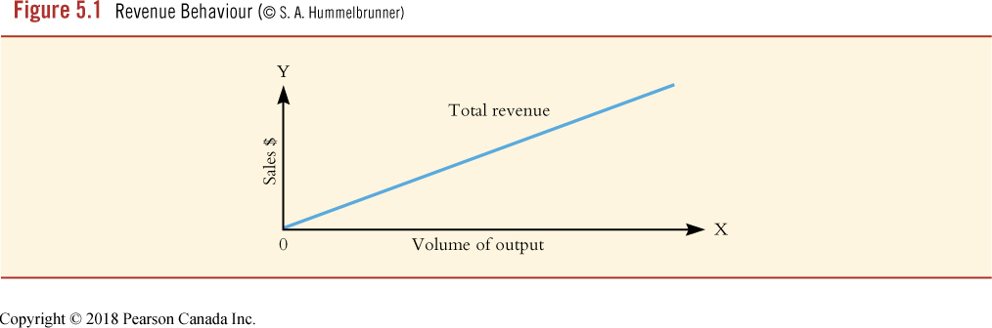
Revenue Function
TR = SP × X

Slide 20
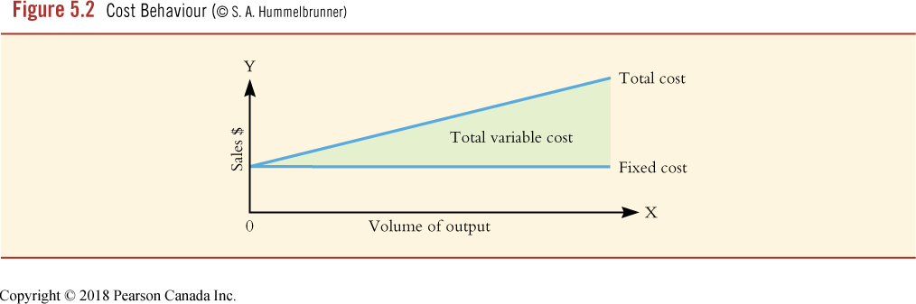
Cost Function
TC = FC + (VC × X)

Slide 21
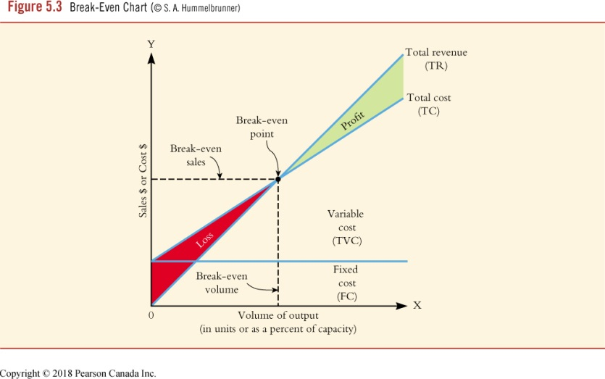
Break-Even Chart
Point at which the total revenue line and the total cost line intersect is the break-even point.
Point of intersection on the horizontal axis of the perpendicular dashed line drawn from the break-even point to the horizontal axis indicates the break-even volume in units or as a percent of capacity.
Point of intersection on the vertical axis of the perpendicular dashed line drawn from the break-even point to the vertical axis indicates the break-even volume in dollars.

Slide 22
Case
For Jason’s geenhouse growing business, graph the following cost-volume-profit relationships and determine the break-even point;
revenue function;
cost function;
break-even chart

Slide 23
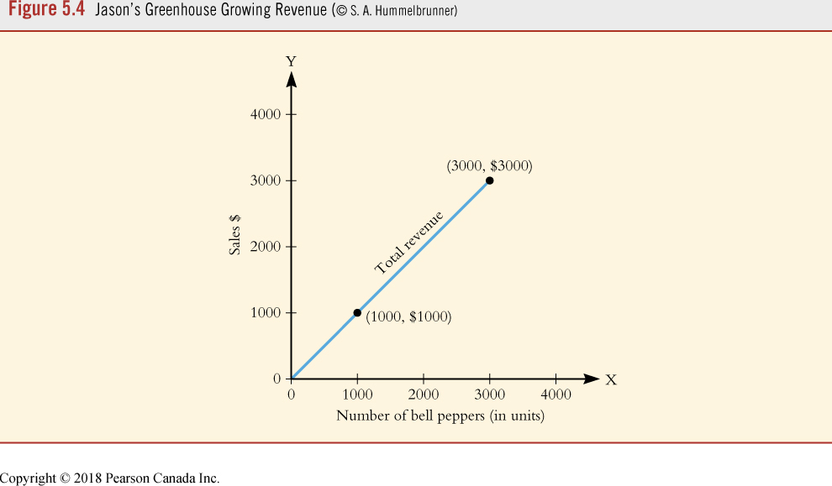
Case Revenue Function
Bell peppers sold for $1 each;
TR = 1 × X
TR = X

Slide 24
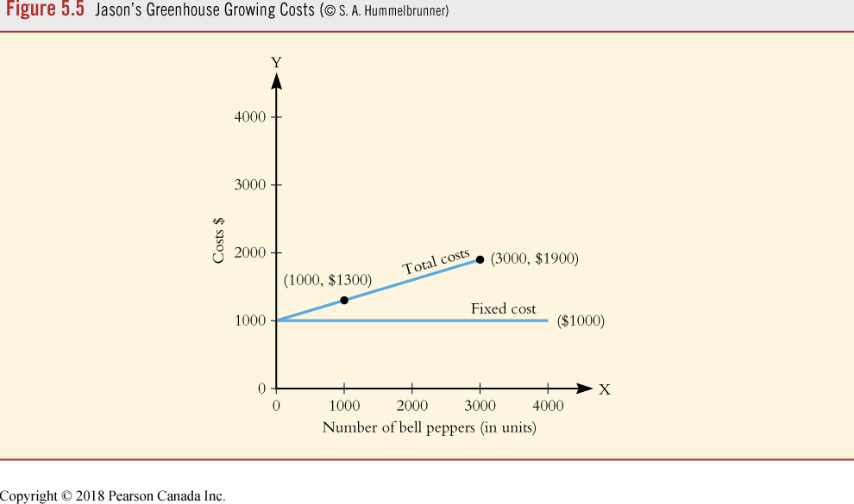
Case Cost Function
Rental is $500
Upgrade is $500
Materials & supplies is 30 cents/pepper
TC = FC + (0.30 × X)
TC = 1000 + 0.30X

Slide 25
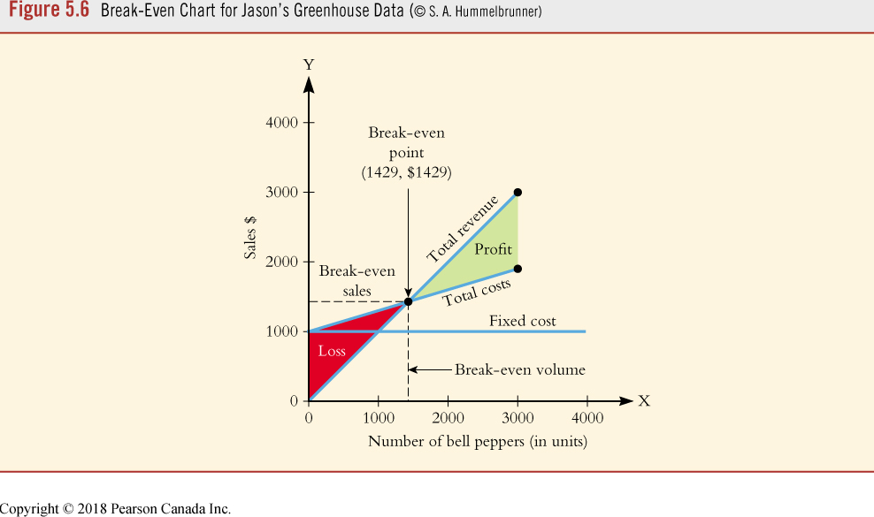
Case Break-Even
TR = TC
Area of loss is the area between the total revenue and total cost lines, below the break-even point.
Area of profit is the area between the total revenue and total cost lines, above the break-even point.

Slide 26
Case Break-Even Point
To break-even, Jason must produce and sell 1429 bell peppers for a total of $1429 in total revenue.
If he produces and sells fewer than 1429 bell peppers, he will incur a loss.
If he produces and sells more than 1429 bell peppers, he will earn a profit.

Slide 27
Case Algebraic Solution
To break-even Profit must be zero (PFT = 0)
Which means TR = TC
1X = 1000 + 0.30X
0.70X = 1000
X = 1428.57 → 1429

Slide 28
Calculating Break-Even When the Unit Prices and Unit Costs are Unknown
When the sales and variable costs are only available in total dollars (not $/unit), a relationship between total sales and total variable costs can be determined.
Note that, in the given information, the net income (or profit) is not zero.
Determine the break-even point in sales dollars by assuming that the price per unit is $1.
You can now calculate the variable cost per unit by dividing the total variable costs by the total sales.
The break-even point can then be calculated.

Slide 29
Contribution Margin and Contribution Rate (1 of 3)
Alternative to using the break-even relationship TOTAL REVENUE = TOTAL.
COST, we can use the concepts of contribution margin and contribution rate to determine break-even volume and sales.

Slide 30
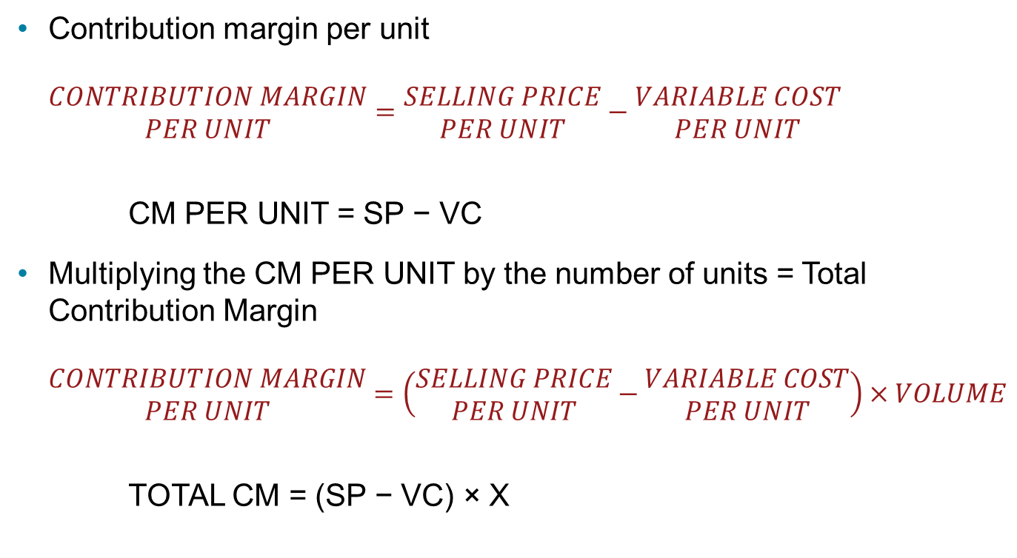
Contribution Margin and Contribution Rate (2 of 3)
Contribution margin per unit
$$\begin{matrix}CONTRIBUTION MARGIN \\ PER UNIT\end{matrix}=\begin{matrix}SELLING PRICE \\ PER UNIT\end{matrix}−\begin{matrix}VARIABLE COST \\ PER UNIT\end{matrix}$$
CM PER UNIT = SP − VC
Multiplying the CM PER UNIT by the number of units = Total Contribution Margin
$$\begin{matrix}CONTRIBUTION MARGIN \\ PER UNIT\end{matrix}=\left(\begin{matrix}SELLING PRICE \\ PER UNIT\end{matrix}−\begin{matrix}VARIABLE COST \\ PER UNIT\end{matrix}\right)×VOLUME$$
TOTAL CM = (SP − VC) × X

Slide 31
Contribution Margin and Contribution Rate (3 of 3)
We can express profit PFT in contribution margin format as
(SP – VC) × X − FC = PFT

Slide 32

Break-In Volume in Units
The break-even volume is reached when the accumulated contribution margin of a number of units covers the fixed costs.
$$\begin{matrix}BREAK−EVEN VOLUME \\ IN UNITS\end{matrix}=\frac{FIXED COST}{UNIT CONTRIBUTION MARGIN}$$

Slide 33
Case Jason’s Greenhouse Growing Project (1 of 5)
Each additional pepper sold increases the revenue by $1.
At the same time, costs increase by the variable cost (materials and supplies) of $0.30 per pepper. As a result, the profit increases by the difference, which is 1 − 0.30 = 0.70.
This difference of $0.70, which is the selling price of a unit less the variable cost per unit, is the contribution margin per unit.

Slide 34
Case Jason’s Greenhouse Growing Project (2 of 5)
If Jason sells one pepper:
If Jason sells ten peppers:
revenue increases by $1;
total cost increases by $0.30 to $1000.30;
profit = 1 − 1000.30 = −$999.30 (loss)
The sale of one unit decreases the loss by $0.70
The contribution margin of $0.70 has absorbed $0.70 in fixed cost.
Total revenue = 10($1)
Variable cost = 10($0.30) = $3
Total costs = 1000 + 3 = $1003
Loss = 10 − 1003 = $993
Reduction in loss = $7
Reduction in loss represents contribution margin for 10 units ($7 in fixed costs absorbed)

Slide 35
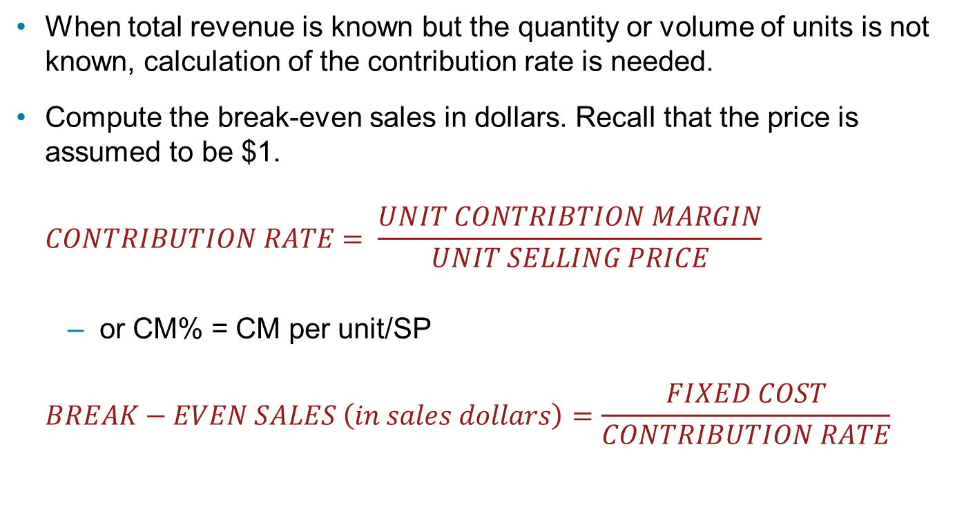
Contribution Rate
When total revenue is known but the quantity or volume of units is not known, calculation of the contribution rate is needed.
Compute the break-even sales in dollars. Recall that the price is assumed to be $1.
$$CONTRIBUTION RATE= \frac{UNIT CONTRIBTION MARGIN}{UNIT SELLING PRICE}$$
or CM% = CM per unit/SP
$$BREAK−EVEN SALES \left(in sales dollars\right)=\frac{FIXED COST}{CONTRIBUTION RATE}$$

Slide 36

Case Jason’s Greenhouse Growing Project (3 of 5)
The contribution rate of $0.70 is expressed as a fraction of the unit selling price.
$$\frac{0.70}{1}=0.70=70\%$$

Slide 37
Effects of Changes to Cost-Volume-Profit
The relationships between cost, volume, and profit makes it possible to determine the effects of changes to any of the variables of the formula.
This type of analysis is called “what-if analysis,” or sensitivity analysis.

Slide 38
Case Jason’s Greenhouse Growing Project (4 of 5)
Recall that the unit price is $1 and the fixed cost is $1000. If variable costs increase to $0.40 for each pepper what is the new break-even point in units?
New variable cost per unit is $0.40
TR = TC
1X = 1000 + 0.40X
0
60X = 1000
X = 1666.67
The new break-even would be 1667 peppers.

Slide 39
Case Jason’s Greenhouse Growing Project (5 of 5)
What If the material cost remains at the original $0.30, the rental cost is decreased to $300, and he sold 3000 peppers, what would be the resulting profit?
PFT = (1 × 3000) − 800 − (0.30 × 3000)
PFT = 3000 − 800 − 900
PFT = 1300
New resulting profit would be $1300.

Slide 40
Summary
The break-even model is used to analyze the relationships among costs, volumes, and profits.
The break-even point is that value at which the total revenue = total cost and can be found graphically and algebraically.
Analysis of business models using contribution margins, rates can lead to a better understanding of a business and its viability

